Slide 1


Project Dashboard
Oviya T

Slide 2

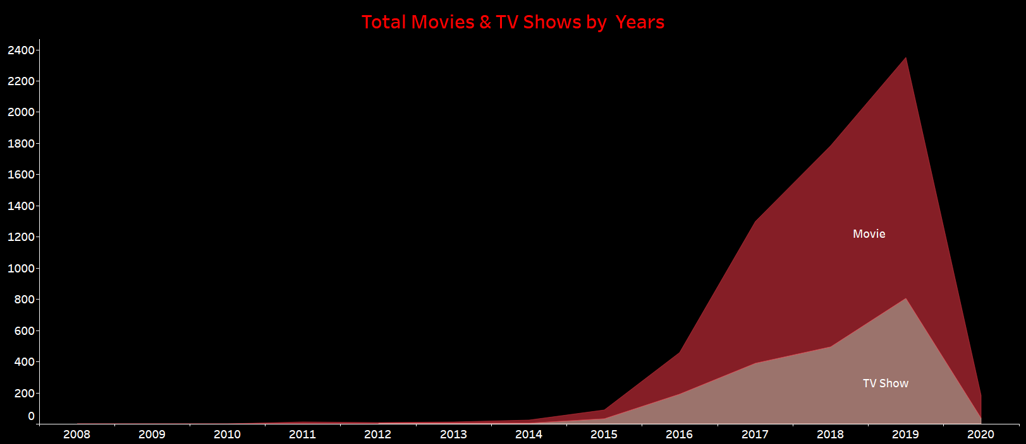
Line Area Graph showing the count of show IDs by year added.
More movies were added between 2015 and 2020 compared to TV shows.

Slide 3

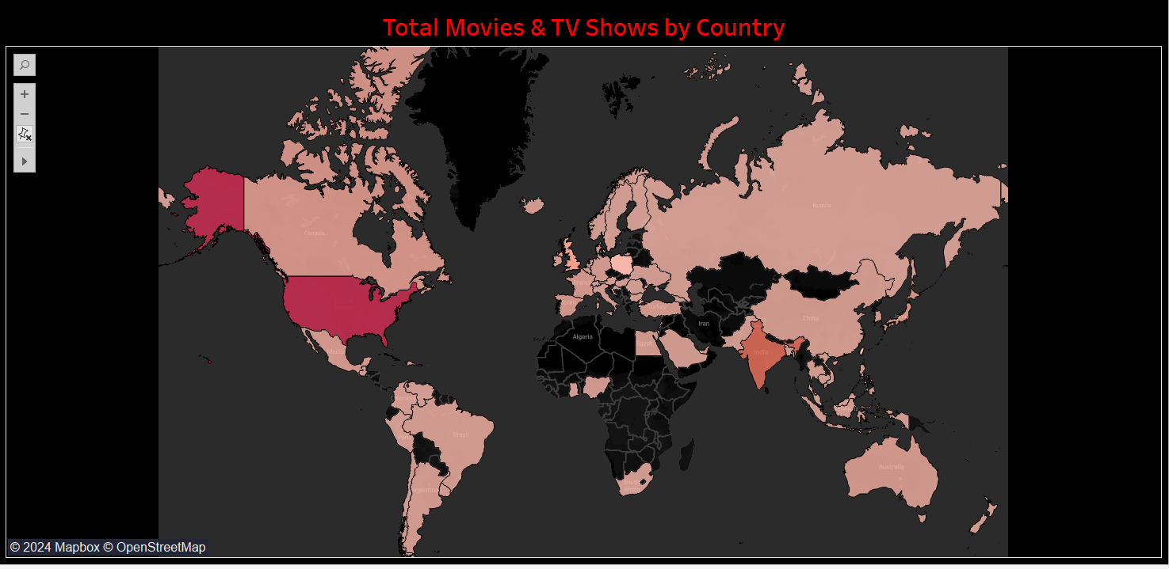

World Map showing the count of show IDs by country.
According to the color grading, the USA has the most show IDs, followed by India.

Slide 4
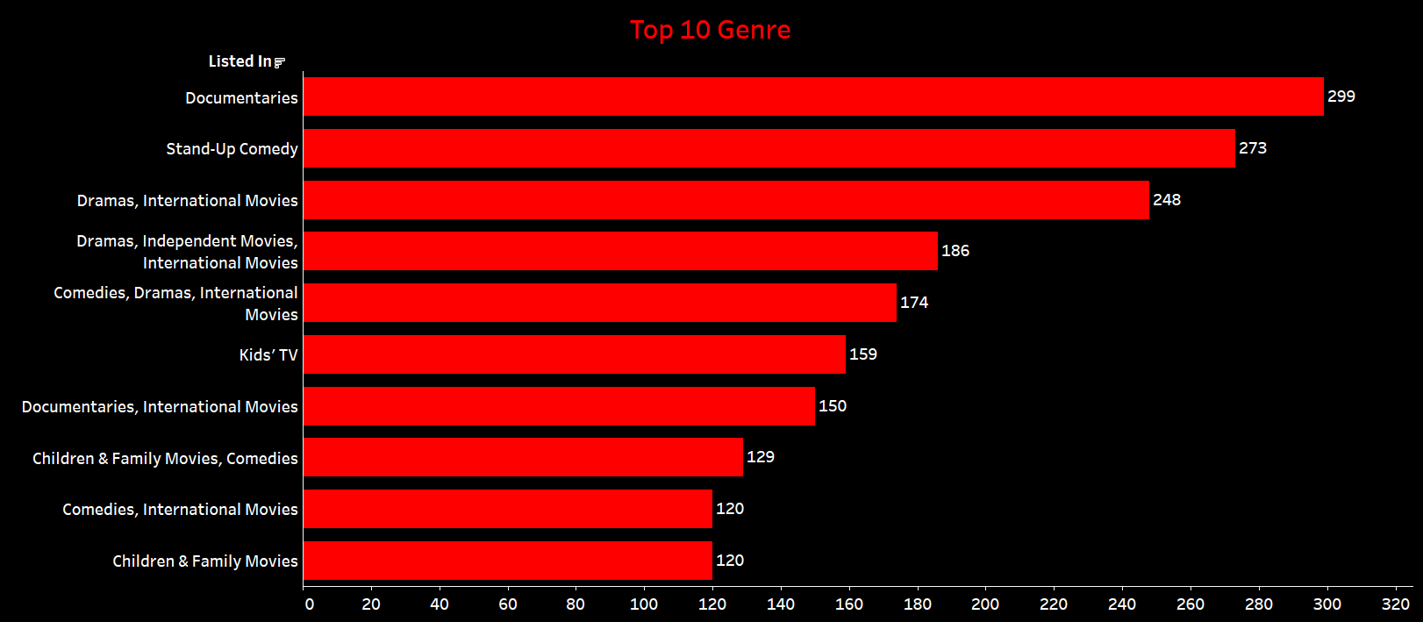
Horizontal Bar Graph of Relation Between Top 10 Gerne and Movie & TV Shows count
Horizontal Bar Graph of Relation Between Top 10 Gerne and Movie & TV Shows count
3) Horizontal Bar Graph of Relation Between Top 10 Gerne and Movie & TV Shows count
Horizontal bar graph showing the relationship between the top 10 genres of movies and TV shows.
The Documentary genre has the highest count of shows followed by Stand-Up Comedy.

Slide 5
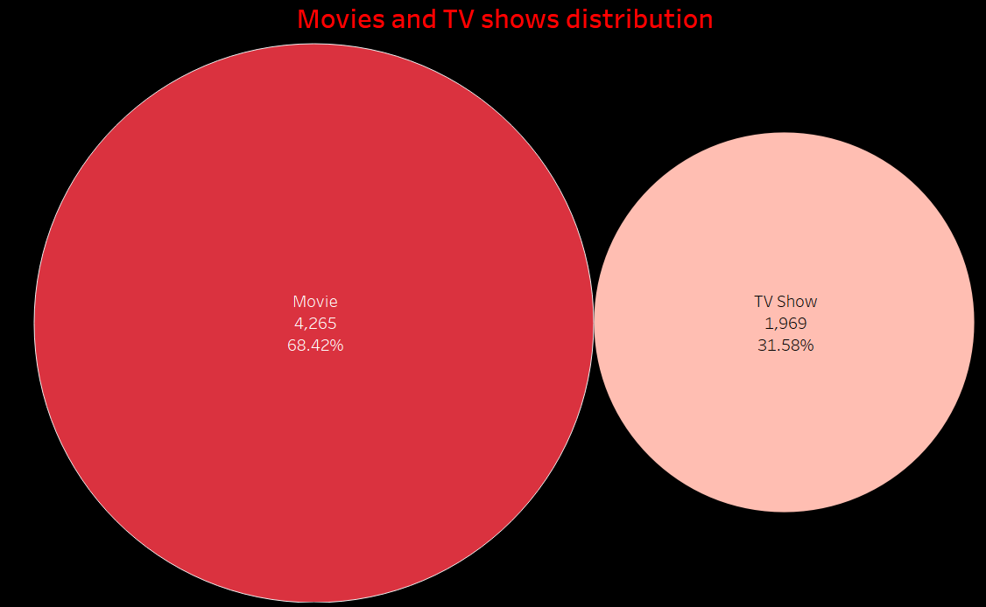
Pie-Chart showing the distribution of movies and TV shows.
Movies have the Highest distribution compared to TV shows.

Slide 6
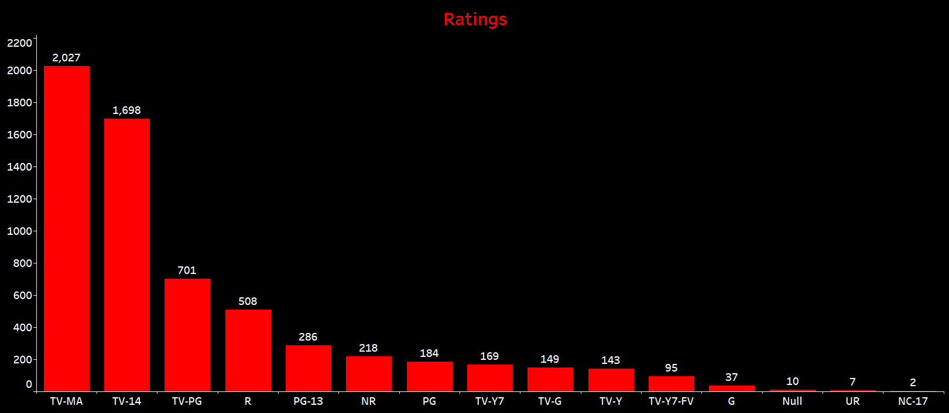
Vertical bar graph showing the relationship between the Rating of movies and TV shows.
TV-MA has the highest count of shows, while NC-17 has a very low count.

Slide 7
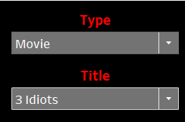

Drop down to select the type of show.
Drop down to select title of the movie or TV show.
To display the details of a particular movie or TV show, including rating, duration, release year and date added

Slide 8


To display the description of a particular movie or TV shows.
To display the genre of particular movie or TV shows.

Slide 9
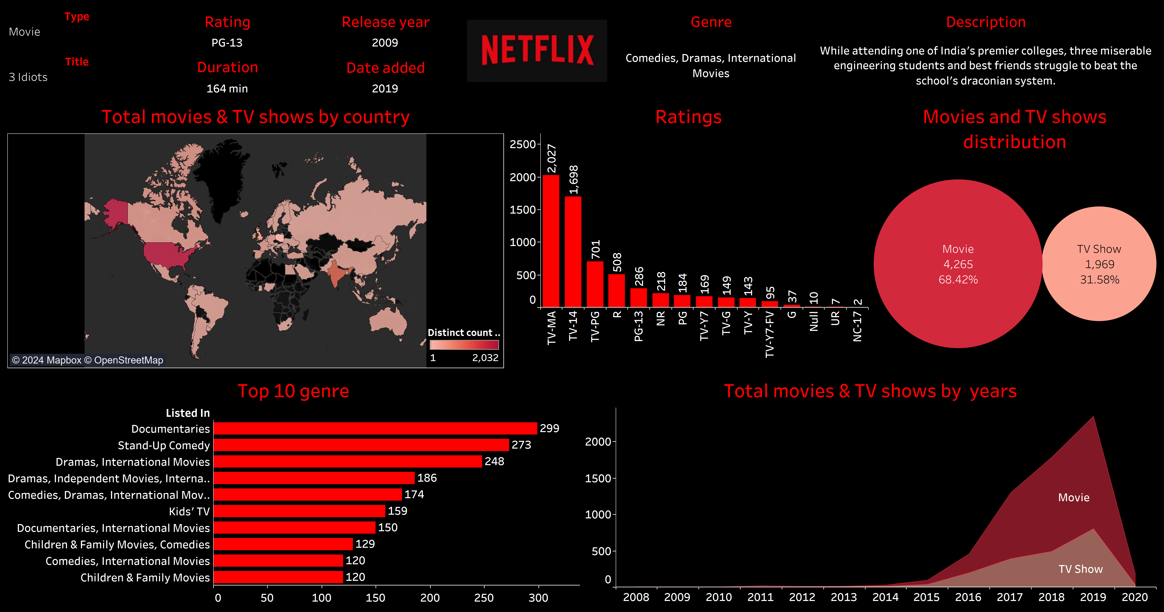
Dashboard

Slide 10

Thank you!

